Slide 1
EASEE-gas & Edig@s
SSO & LSO Joint Workshop
July 3rd 2024

Slide 2
Introduction to EASEE-gas and Edig@s
Oliver Schirok
VNG Handel & Vertrieb
Chairman MWDWG

Slide 3
Workshop Agenda
Introduction to EASEE-gas and Edig@s
Storage customer requirements
Storage business process and messages for inventory and capacity
Storage business process and messages for transfer
LNG business process and messages
Q&A Session

Slide 4
About EASEE-gas
EASEE-gas promotes and develops solutions for the simplification and streamlining of the trading and physical transfer of gas.
FOUNDED IN 2002
80+
EUROPEAN
MEMBERS

Slide 5
Represents the entire gas value chain
Transmission System Operators
Producers
Distribution System Operators
End-users
Storage System Operators
Prosumers
LNG System Operators
Suppliers
Traders & Shippers

Slide 6
Membership by category
Producers
Transmission System Operators
Distribution System Operators
Storage System Operators
LNG System Operators
Traders & Shippers
Suppliers
End-users
Prosumers
Service Provider
67 FULL MEMBERS
15 SERVICE PROVIDER MEMBERS

Slide 7
Members across Europe
Producers
Transmission System Operators
Distribution System Operators
Storage System Operators
LNG System Operators
Traders & Shippers
Suppliers
End-users
Prosumers
Service Provider

Slide 8
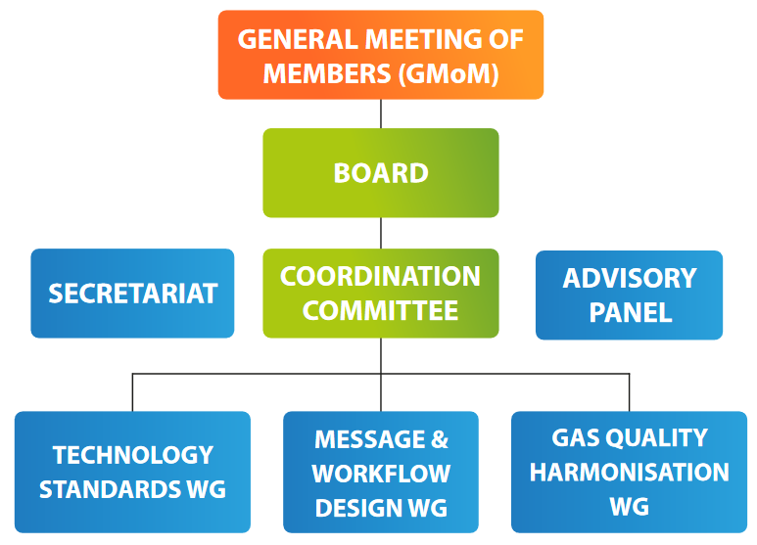
Organisation Structure

Slide 9
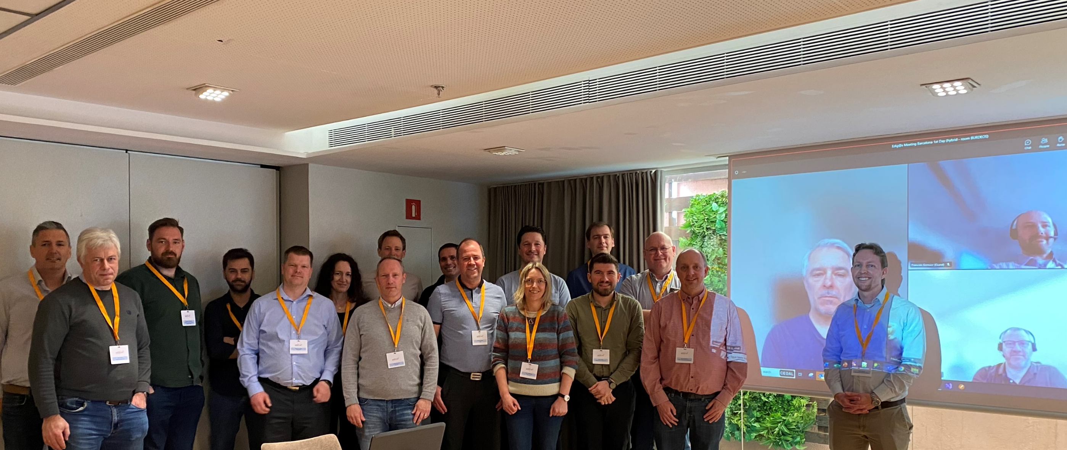
Edig@s working group | Who are we?

Slide 10
Edig@s working group | Who are we?

Slide 11
MWDWG Meeting Schedule 2024
Host Company | Location | Dates
Gascade | Kassel (Hybrid) | February - 6/7
EASEE-gas GMoM | Nice (Hybrid) | March - 20/22
Gassco | Haugesund (Hybrid) | April - 24/25
Energinet | Copenhagen (Hybrid) | June - 03/04
Conexus | Riga (Hybrid) | July - 02/03
Gaz System | Warsaw (Hybrid) | September - 03/04
Amber Grid | Vilnius (Hybrid) | October - 22/23
VNG | Berlin (Hybrid) | November - 26/27
ENTSOG - Joint workshop | Brussels (physical) | October 29/30

Slide 12
MWDWG in numbers (2023)
8
Hybrid workgroup
meetings
conducted
12
Task force
meetings
held
32
Different companies represented
40
Maintenance
requests handled

Slide 13
Covered Business Processes
Capacity Allocation
Gas Trading
Nomination & Matching
Balancing & Settlement
REMIT & Transparency
System Operation
17

Slide 14
MWDWG Goal

Slide 15
What do we want to achieve?
Edig@s promotion & awareness
Workshop with SSO’s
Engage with TSO’s connected to existing Edig@s market
Balancing process
Monitor the development of new gas markets
Hydrogen networks
CO2
Future market design
Review proposed network code changes
CAM/CMP
NC INT
Maintenance of version 6.1
18

Slide 16
Edig@s 6.1 implementation status
Publication of version 6.1 in February 2022
In 2023 first members started exchanging version 6.1 messages
Phase 1: Nomination & Matching, OTC Gas Trading, General Process
Phase 2: Balancing & Settlement, Capacity Allocation, System Operation
Implementation support available – do not hesitate to contact us !

Slide 17
Storage customer requirements
Svetlana Pozdysheva
Engie

Slide 18
(focus on short term activities)
Why storage products
Portfolio balancing
Optimisation
B2B/B2C/Power Plant segment balancing (in particular Within Day shape induced by customer demand)
Delivery incidents,
System shortfalls
Usage
Optimize residual capacities
Within Day vs Day Ahead arbitration (temporal spreads)

Slide 19
What data we need to manage our storage assets
Asset steering.
The information needs to be made available (PUSHed) as soon as it becomes available.
Operational
Confirmed quantities,
Short term capacity transactions (working volume)
Provisory allocations (for hourly products) : injection/withdrawal, inventory
Operational daily minimum/maximum limits
Guaranteed daily minimum/maximum limits
Available additional capacity (UIOLI, UBI ...)
Variable costs (FG, Euros ...)
Automated feed of contractual data for asset configuration
Invoicing
Contractual
Subscribed injection / withdrawal capacities
Scheduled maintenances
Storage inventory limits
Working volume
Allocations (Settlement)
Definitive Allocated volumes
Harmonized format (Edig@s) and communication means

Slide 20
What we’ve got ...
Nomination & Matching
Nomination & Matching
Mostly harmonized via Edig@s messages
System operation data and Allocations
Heterogeneous formats and means of retrieval (push, pull)
Current situation requires specific connectors per storage operator
Edig@s messages
Storage system operator
Balance responsible party
Edig@s, APIs, EXCEL/CSV, Proprietary formats, Variety of communication means
Operational data,
Contractual data,
Allocations

Slide 21
Operational processes covered by Edig@s messages
Storage inventory position
Storage rights and capacities
Allocation and Settlement
INVENT
Exchange regarding quantities to be committed for injection / withdrawal
MARSIT
LIMITS
Transfer or receipt of stock or ownership in a facility
FLOWRQ
STOREQ / STOCON
Nomination & Matching
NOMINT / NOMRES / DELORD / DELRES

Slide 22
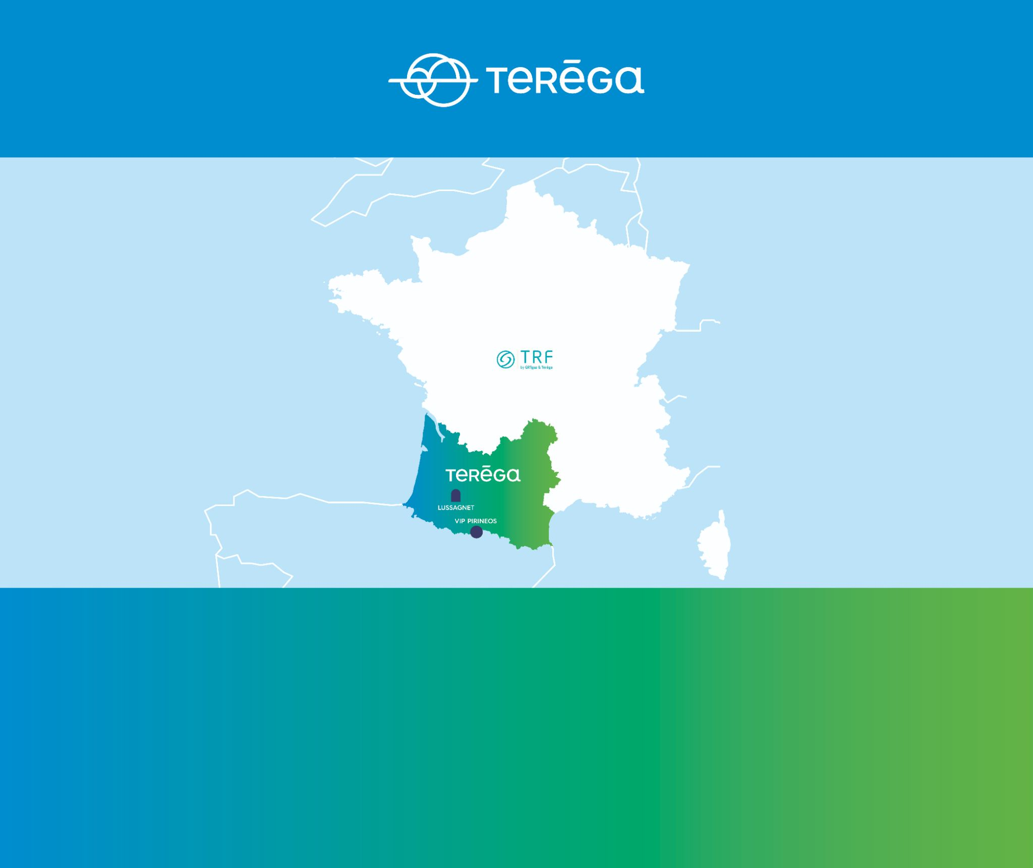
Storage business process and messages for inventory and capacity
Catherine Galiay
Teréga

Slide 23
Business Process – Operational limits and Inventory
1) Storage contracts determine Volume, Injection and Withdrawal rights and obligations
Withdrawal rights
Injection rights
Volume rights
Volume
GWh
500
Withdrawal
MWh
Injection
MWh
0
0
0
0
Filling level
500
0
Filling level
500
April
Nov.
Mar.
2) Maximum and minimum Inj/Withd. capacities may depend on the storage level and also operational conditions such as maintenances. Storage level positions may be overrun/shortfall.
3) Storage users need up-to-date information for both provisional and definitive data

Slide 24
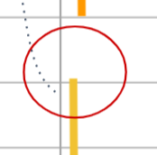
LIMITS message
Limits supported by the message
Withdrawal
MWh
Withdrawal rights
Nominal injection and withdrawal maximum capacities
Daily injection and withdrawal maximum limits
Daily injection and withdrawal minimum and maximum Operational limits
200
160
Guaranteed Operational injection and withdrawal minimum and maximum limit (Specific case for Daily limit = fixed volume for past hours + operational limit for rest of the day)
80
with a reduction rate applied on withdrawal.
Daily maximum and minimum storage level expressed in kWh
0
Volume rights
0
Storage Level
500
GWh
500
Flexible message, supporting various storage models :
Min injection
Max withdrawal would be set to 0
Daily or Hourly
Firm or Interruptible
Provisional or Definitive
Debit or Credit
0
If the projected storage level is below the minimum level for the Day
April
Nov.
Mar.
Notes:
The limits can provide the following data for injection and withdrawal:
Nominal injection and withdrawal maximum capacities. The maximum quantity of gas that the customer can inject or withdrawal equal to units subscribed under the Contract
Daily injection and withdrawal maximum limits. The quantity of gas that can be injected/withdrawn due to injection/withdrawal factors. It is determined each day by multiplying the Nominal Injection/Withdrawal capacity by the Injection/Withdrawal development factor for the Day in question (This capacity uses the projected inventory level)
Daily injection and withdrawal minimum and maximum Operational limits. Daily Injection/Withdrawal limits (per hour/day) (Firm / Interruptible) are Daily limits eventually reduced by a reduction rate and then eventually advised to respect the storage level limits. In case of current storage above the storage limits there will be a minimum advised Injection to respect the minimum Storage level, and minimum advised withdrawal to respect the maximum storage level. This value is contextual.
Guaranteed Operational injection and withdrawal minimum and maximum limit. This is an updated Daily operational limit which takes into account the within-day fixed volume. Sum of schedule injection/withdrawal quantities on past hours within day (Already fixed volume in daily managed regimes / storages for past hours for injection/withdrawal) and daily injection/withdrawal limit for remaining hours. This is a daily capacity. These data for each hour are already fixed volume for the past hour, or daily operational limit for future hours.
The limits provide the following data for volume:
Daily maximum and minimum storage level expressed in kWh. This is contractual data, defining the minimum and maximum quantity of gas that the Balance Responsible Party must retain in the storage facility on a given day.

Slide 25
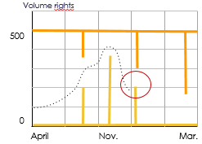
INVENT message
Data supported by the message :
Allocated inventory level
Real time inventory level A provisional at one time of the day
Projected inventory level An estimated at the end of day
Allocated storage overrun / shortfall
D-1
D
D+1
Flexible message, supporting various storage models :
In this example, if there is no injection done (or not enough), this can lead to a shortfall.
Daily or Hourly
Projected, Provisional or Definitive
Debit or Credit
D
Notes:
Projected inventory level. An estimated quantity of gas in the storage facility for one day (at the end of day) for each Balance Responsible Party and product. The quantity is calculated based on the previous day's stock and the daily injection and withdrawal schedules and is used within day and for future gas days for limits and capacity calculations. For inventory levels, a positive inventory should be reported as a credit quantity, and a negative level should be reported as a debit quantity.
Real time inventory level: A provisional quantity of gas in the storage facility at one time of the day corresponding to within day confirmation deadlines. The data provided has the status “Provisional”. The timeStamp indicates the specific time corresponding to the quantity in storage. For inventory levels, a positive inventory should be reported as a credit quantity, and a negative level should be reported as a debit quantity.
Allocated inventory level. The allocated quantity of gas in the storage facility deemed to contain for one day (end of day) under the contract. The data provided could have 2 statuses - provisional (day after) or definitive (e.g., month after). For inventory levels, a positive inventory should be reported as a credit quantity, and a negative level should be reported as a debit quantity.
Allocated storage overrun or shortfall. The quantity of gas that exceed the minimum and maximum storage level limits for one day. This quantity can be purchased by the Storage System Operator from the Balance Responsible Party on a given day to cover a maximum stock overrun or sold by the Storage System Operator to the Balance Responsible Party on a given day to cover shortfall (minimum stock overrun). The data provided could have different statuses - e.g. provisional (day after) or definitive (e.g., month after). Shortfall should be reported as a debit quantity, and overrun should be reported as a credit quantity.
Fuel gas. The quantity of gas should be reported as a debit quantity to describe fuel gas subtracted from a recipient account to cover System Operator usage of gas for specific operation of the system, i.e. injection processes or regasification processes. The quantity of gas should be reported as a credit quantity to describe a process when System Operator returns in part or fully previously subtracted amount or for any other reason returns amount of gas to recipient account.

Slide 26
Storage business process and messages for transfer
Janis Vilims
Conexus Baltic Grid

Slide 27
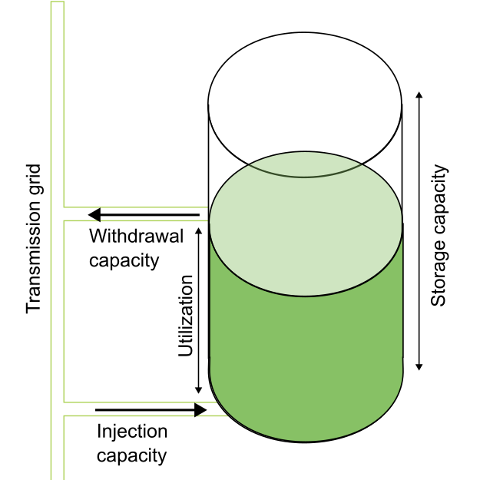
General storage business process
Storage capacity
Amount of storage space available to store energy (gas) Very often storage capacity could cover one or several storage cycles
Withdrawal capacity
Amount of energy available to storage user per gas day or gas hour to take out gas of storage
Injection capacity
Amount of energy available to storage user | per gas day or gas hour to inject into storage
… other, storage specific elements
17
Notes:
Main reasoning for Transfer messages.

Slide 28
Business Process – Transfers
Necessity – to perform transactions within storage
1. Transfer of commodity (gas)
2. Transfer of capacity (storage, withdrawal, injection, product)
3. Transfer of capacity + commodity («all-or-nothing» scenario)
4. More complex or market-specific transactions
Products:
Sets of rights to use certain activities at storage (storages).
Example: SBU or Standard Bundled Unit (Storage capacity, injection and withdrawal capacities)
17
Notes:
Main reasoning for Transfer messages.

Slide 29
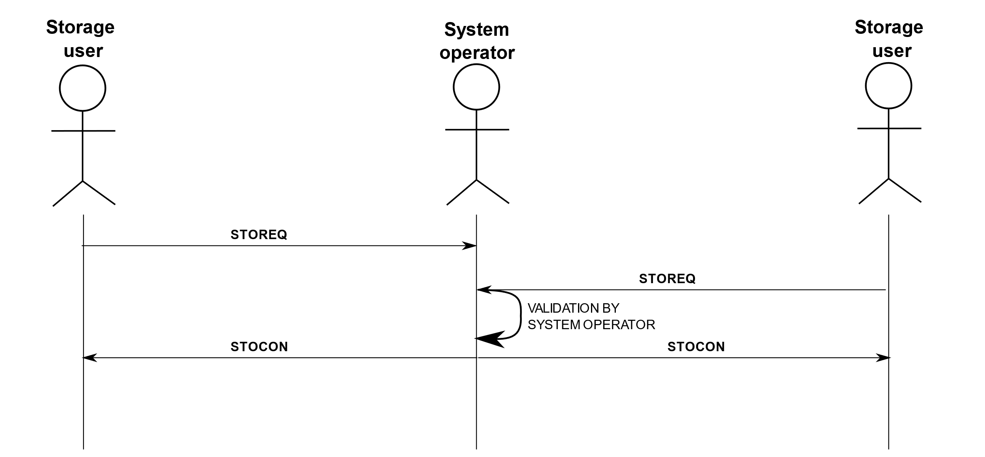
STOREQ / STOCON Messages
Solution:
To implement standardized yet flexible messaging solution to cover as many cases as possible
17

Slide 30
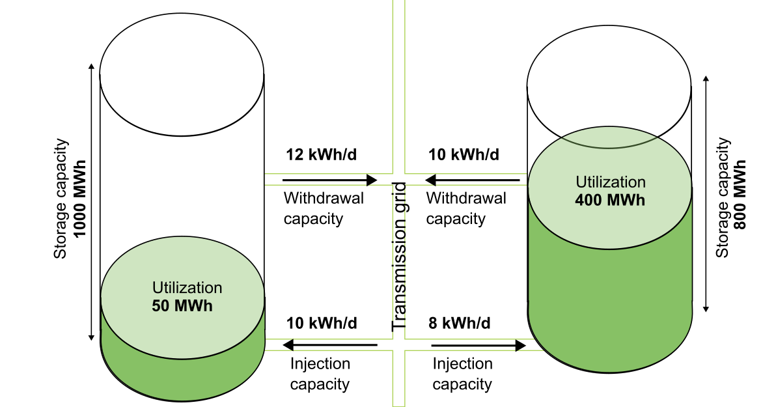
Use case examples
Transfer of commodity
Before the transaction
Storage user 1 (SU1)
Storage user 2(SU2)
Storage
17

Slide 31
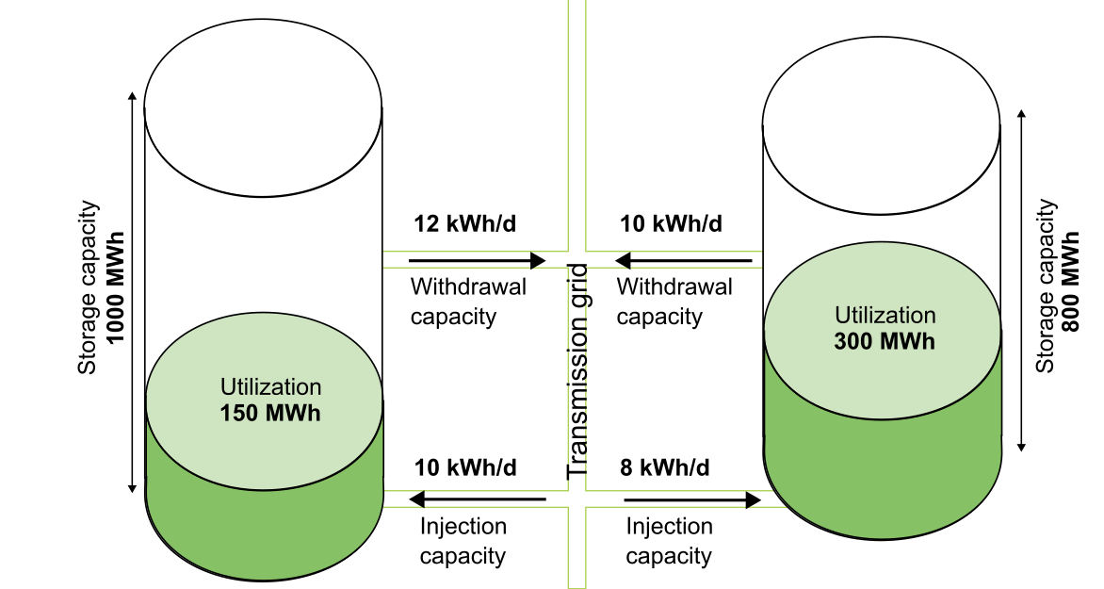
Use case examples Transfer of commodity
Transfer 100 MWh commodity
Storage user 1 (SU1)
Storage user 2(SU2)
STOREQ
STOREQ
STOCON
STOCON
Storage
Each storage user
keeps their
product rights
17
Notes:
Add arrow with 100 Mwh from SU2 to SU1
Message exchange (STOREQ and STOCON)
Why NOT use NOMINT

Slide 32
Use case examples
Transfer of capacity + comodity
Before the transaction
Storage user 1 (SU1)
Storage user 2(SU2)
Storage
17

Slide 33
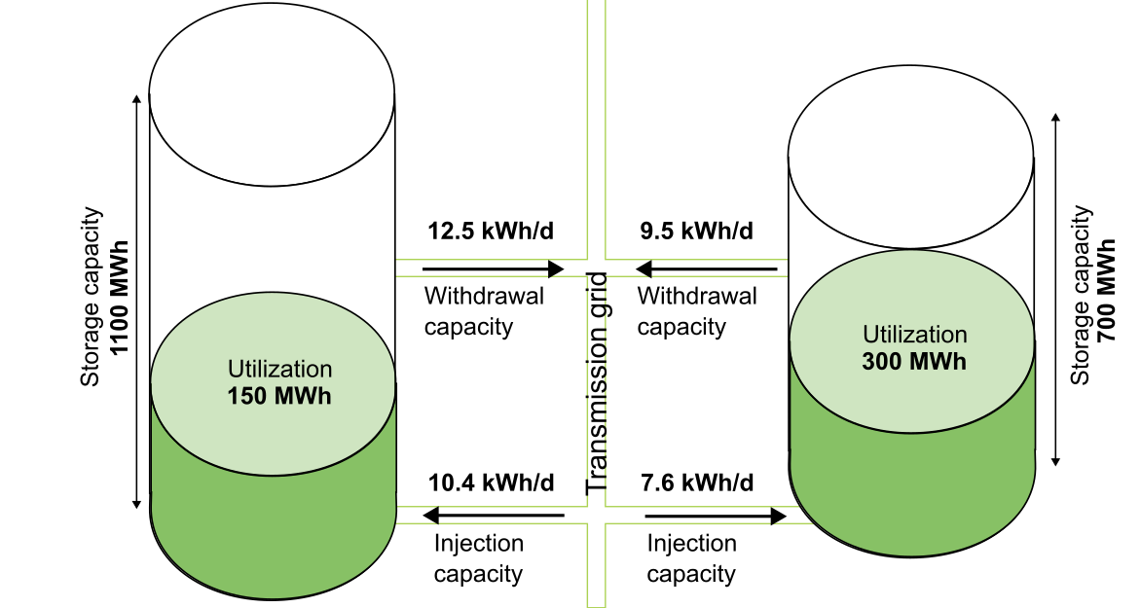
Use case examples Transfer of capacity + commodity
Transfer 100 MWh capacity + commodity
Storage user 1 (SU1)
Storage user 2(SU2)
STOREQ
STOREQ
STOCON
STOCON
Storage
Each storage user
has updated
product rights
17
Notes:
Changed withdrawal and injection capacity rights

Slide 34
LNG business process
Jeremy Devillers
Fluxys

Slide 35
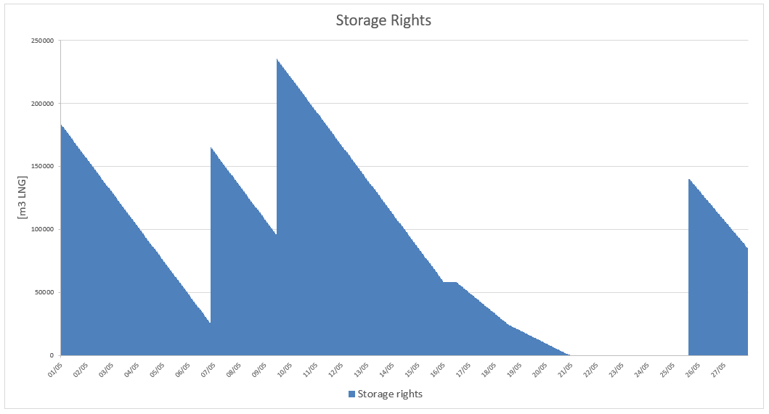
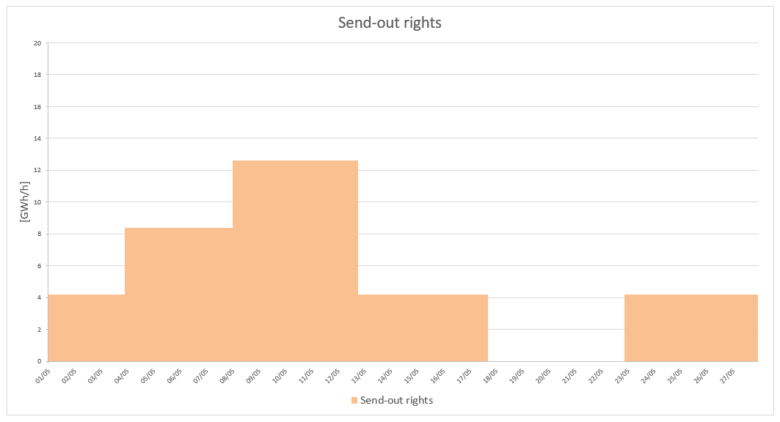
Business Process – LNG messages
1) LNG contracts determine Volume rights, Send-out rights and obligations
2) These rights may depend on the period and activities. Operational conditions such as maintenances also have an impact.
Mainly 2 cases:
Terminal user with a long-term contract and flat rights over the contractual period → no need to exchange this on a regular basis
Terminal user receiving more rights when an operation is on schedule → more fluctuation, implying a real added value to exchange this information via messages
LIMITS message offers a solution to communicate this in a flexible way: Volume / Send-out / Injection Rights
Hourly / Daily
Interruptible / Firm
Provisional / Definitive
17

Slide 36
Business Process – LNG messages
3) LNG Inventory position is a crucial information for a Terminal User.
INVENT message offers a solution to communicate this in a flexible way:
Inventory Level / Overrun / Shortfall / Fuelgas
Hourly / Daily
Projected / Provisional / Definitive
4) Certain flow rates may be necessary to ensure the safety of the installation.
FLOWRQ message offers a solution to communicate this in an easy way, replacing emails or phone calls efficiently:
Minimum / Calculated
Input / Output
Hourly

Slide 37
Q&A Session
Download available
https://www.edigas.org/version-6-1

Slide 38
Q&A Session
Question: Is the Edig@s working group aware of the ACER consultation about REMIT II? Will EASEE-gas answer the consultation? TSOs see the need for the Edig@s working group to propose new or adapted messages needed for implementation of the new regulation.
Answer: EASEE-gas is aware of the ongoing consultation and will probably answer, to be decided by the EASEE-gas board. We are also in contact with ACER for future changes on the REMIT process and of course we are ready to help and provide new messages or modifications.
Question: What is the preferred way of exchanging the Edig@s messages presented in the workshop?
Answer: It is recommended to send the messages by an existing protocol that might also be in place already with your business partner, preferably AS4 with the latest ENTSOG profile.
Question: If Storage System Operators have ideas for new products and don’t know how Edig@s messages could fit, what should they do then?
Answer: The best way for an initial contact is to start a maintenance request. The form can be found on the Edig@s website. If this is not sufficient because you want to discuss things more in detail, please feel free to reach out to the speakers of the workshop.

Slide 39
Thank
you for your attention!
Stay updated:
EASEE-gas

